Slide 1
Use case
“Terra Trek”
Group name: ”Cyan”
Munim Ahemd (192-35-477)
Tisha Khandokar (192-35-459)
Afifa Hossain (192-35-453)

Slide 2
A use case diagram is the primary form of system or software requirements for a new software program underdeveloped.
What is use case
It is usually simple. It does not show the detail of the use cases:
It only summarizes some of the relationships between use cases, actors, and systems.
It does not show the order in which steps are performed to achieve the goals of each use case.

Slide 3
Actor of use case:
Primary Actor: A user whose defined user goal and is fulfilled by the system.
The primary actor is often, but not always, the actor who triggers the use case.
Supporting Actor: A user who provides a service information.
A supporting actor also known as a secondary actor. in a use case in an external actor that provides a service to the system under design.

Slide 4
Include & Exclude of use case
Use case include is a directed relationship between two use cases which is used to show that behavior of the user. The include relationship could be used:
to simplify large use case by splitting it into several use cases.
to extract common parts of the behaviors of two or more use cases.
The extending use case is dependent on the base use case. it literally extends the behavior described by the base use case. It can be used to extract out subsequences of the base use case, especially when they represent ‘exceptional’ complex behavior with its own alternative flows.

Slide 5
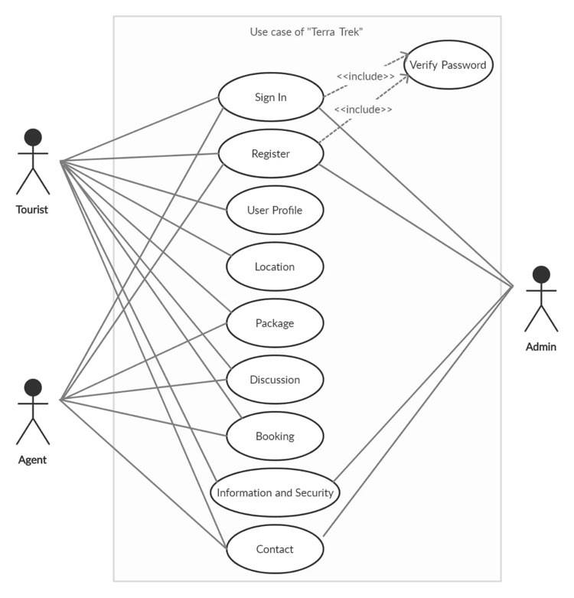
Use-case diagram:

